Slide 1
Deploy Pickle File on Flask
SPAM CLASSIFICATION MODEL

Slide 2
PROC File ➔ Brain
PICKLE FILE
HTML (CSS)
app.py (Python File ( FLASK and our reference to pickle File )
Requirements.txt
Cloud Server ( GCP, AZURE, AWS, Pivotal, Heroku)

Slide 3
<html>
Rest of html code will pe present in side these HTML tags
</html>

Slide 4
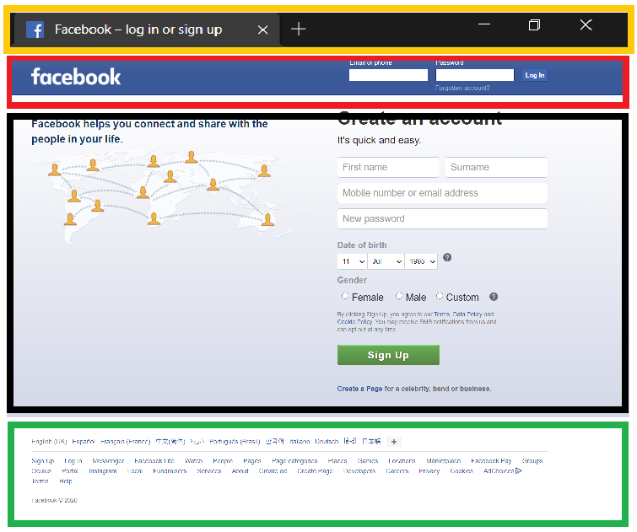

<html>
<head>
</head>
<body>
<header>
</header>
<div>
</div>
</body>
<footer>
</footer>
</html>

Slide 5
<html>
<head>
<title>Home</title>
</head>
<body>
<header>
<div>
<h1> </h1>
<h2> </h2>
<p> </p>
</div>
</header>
<div>
<div>
</div>
</div>
</body>
<footer>
<div>
<div>
</div>
</div>
</footer>
</html>

Slide 6
CSS
html { font-family: sans-serif; background: #eee; }
body{max-width: 960px; font:15px/1.5 Arial, Helvetica,sans-serif;background-color: #ff6699;}
header{ background:#000000;border-bottom:#448AFF 10px solid;height:120px; width:100%;}
p{font-size:30px; text-align:center; color: #cc3300; font-weight:bolder;}
footer {position: relative; height:60px; width: 100%;background-color: #333333;}

